Slide 1

Hurricane Harvey Outreach and Relief Project
Student Researcher: Lisa (Yiyao) Li
Principal Investigator: Dr. William B. Perkison

Slide 2
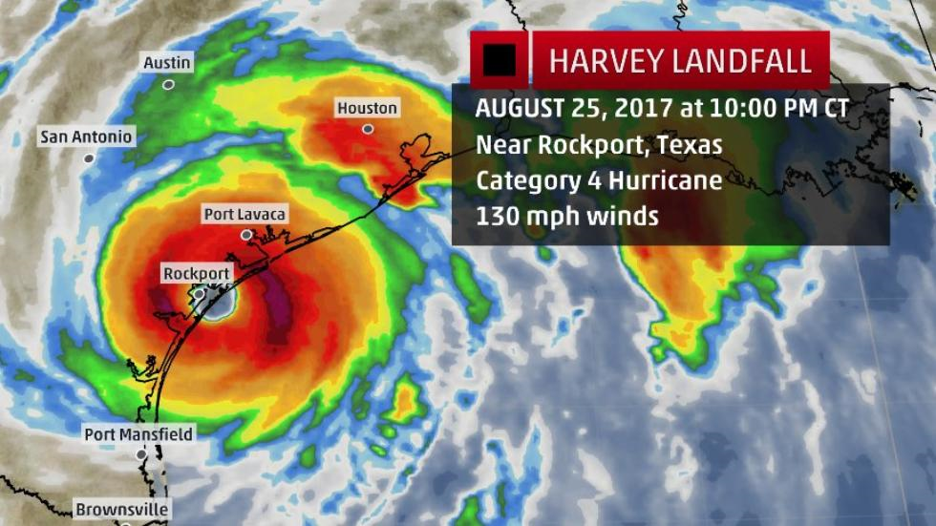
Background: Hurricane Harvey Disaster
Evident that no prior hurricane is comparable to Hurricane Harvey in terms of scope and severity of physical infrastructure damages, economic burden, and adverse health outcomes
Made landfall along Middle Texas Coast on August 25, 2017 - rolled through South and Southeast Texas as well as regions of Louisiana (particularly Southwestern Louisiana)
Eye of Category 4 Hurricane (sustained winds of 130 mph) made landfall between Port Aransas and Port O’Connor, Texas on Friday, August 25, 2017

Slide 3
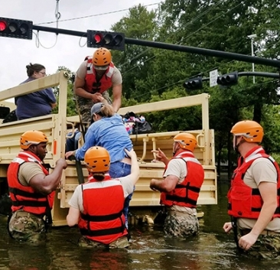
Background: Hurricane Harvey Disaster
Heavy rainfall and flash flooding in several impacted areas of Texas further exacerbated the existing insurmountable burdens on Texan residents
Some areas of Texas received 40 inches of rainfall in less than 48-hour duration – Houston’s Cedar Bayou received a novel record total of 51.88 inches of rainfall
Storm surge levels were estimated to be more than 12 feet above ground level – major river flooding from excessive precipitation was observed at Victoria’s Guadalupe River (crested to its second highest record at 31.25 feet during the late evening of August 30, 2017
After approximately five days of relentless rainfall over South and Southeast Texas, Harvey finally transitioned into Cameron, Louisiana overnight on August 30, 2017

Slide 4
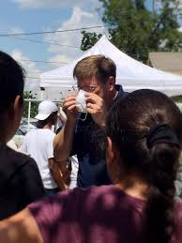
Background: Hurricane Harvey Disaster
Following Hurricane Harvey, the Southwest Center for Occupational and Environmental Health (SWCOEH) at the University of Texas School of Public Health in Houston initiated an aggressive outreach program to provide local residents and workers with necessary personal protection equipment (PPE) to work safely in the aftermath of the storm’s devastation
Trained volunteers coordinated with local churches and agencies to provide exposure prevention kits to local residents
Residents were also asked if they could be contacted in 6 months for a follow up - those who consented provided their contact information

Slide 5
Background: Hurricane Harvey Disaster
Follow up survey was designed to meet the following objectives:
To obtain demographic information and the degree to which their residence was flooded
To determine the impact of the flooding on the physical and mental health
To evaluate the perceived effectiveness of the Hurricane Harvey Outreach and Relief Project in reducing negative health effects

Slide 6
Participant Outreach and Recruitment
SWCOEH program coordinators reached out to an extensive network of religious, charity and academic organizations in Harris County with ongoing outreach efforts, as well as personal and professional acquaintances to find training and distribution sites
A total of 71 trained volunteers conducted community outreach and distributed 1187 exposure prevention kits at 19 training sites in Harris County’s most hard-hit areas
Each kit contained English and Spanish instructions on proper PPE use, a health education factsheet, a NIOSH approved N-95 respirator, a pair of nitrile gloves and a card that included contact information for the University of Texas School of Public Health’s outreach team
Volunteer trainers were given an instructional video detailing proper PPE use to help educate recipients; however, due to the lack of electrical outlets and time, verbal instruction proved to be a more pragmatic approach

Slide 7
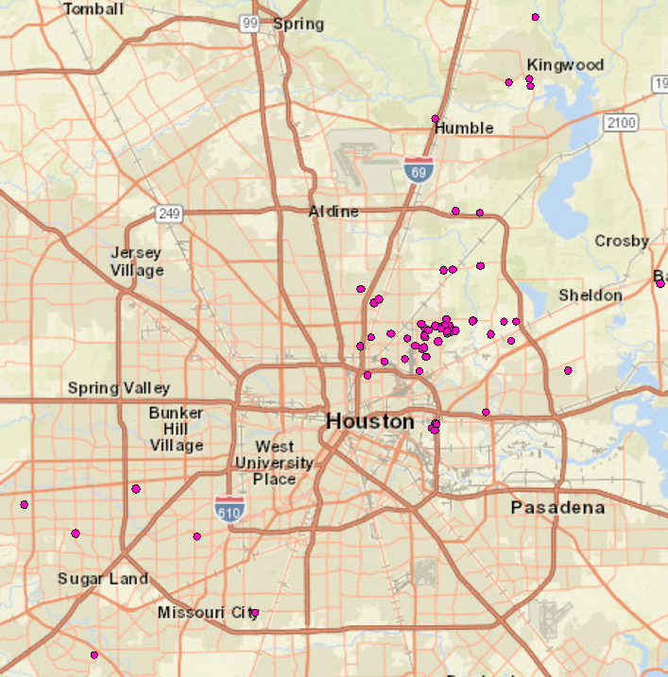
Figure 1. 2017 UTSPH Hurricane Harvey Outreach sites for kit distribution and instruction

Slide 8
Participant Outreach and Recruitment
Local residents received the kits after they were provided with safety education and a demonstration on proper use of the PPE
Volunteers also asked if they could contact recipients in the future for a follow up survey on their status
276 agreed to participate and provided contact information
Between April and August 2018, research SWCOEH staff reached out to the flood victims who agreed to participate in interviews via phone, email, and postal mail (total of 84 participants in final contact list)
83 participants were successfully recruited through telephone-based interviews
4 participants were successfully recruited by electronic mail

Slide 9
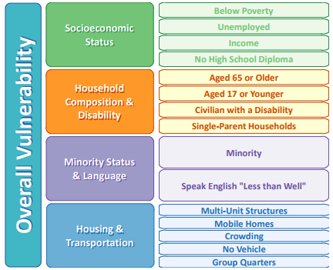
2014 Social Vulnerability Index
Agency for Toxic Substances and Disease Registry (ATSDR), under the Centers for Disease Control and Prevention (CDC), developed the Social Vulnerability Index (SVI) to identify communities that are more vulnerable to the effects of natural disasters
SVI calculates social vulnerability based on census tracts
For each tract, the percentile for each of the four themes is computed and assigned a value ranging from 0 (low vulnerability) to 1 (high vulnerability)

Slide 10
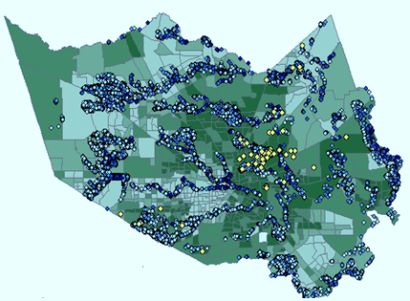
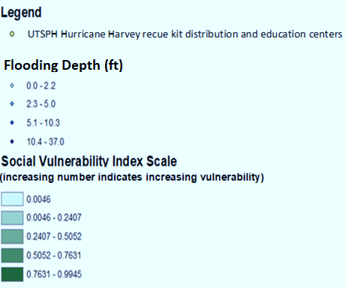
Figure 2. Assessment of flooding depth within residences in Harris County in relation to the Social Vulnerability Index
- Source: U.S

Slide 11
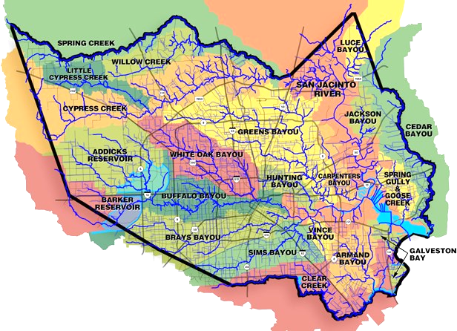
Figure 3. Floodplain distribution within Harris County
- Source: U.S.

Slide 12
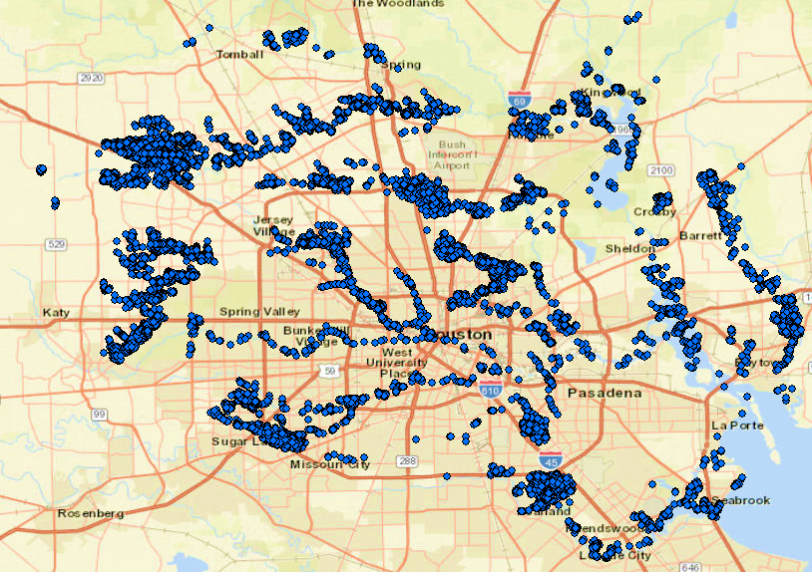
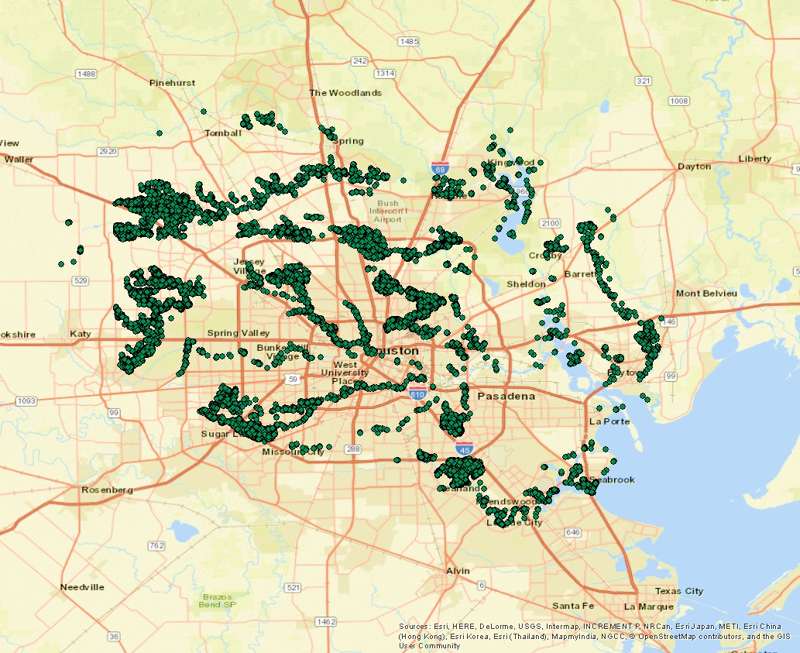
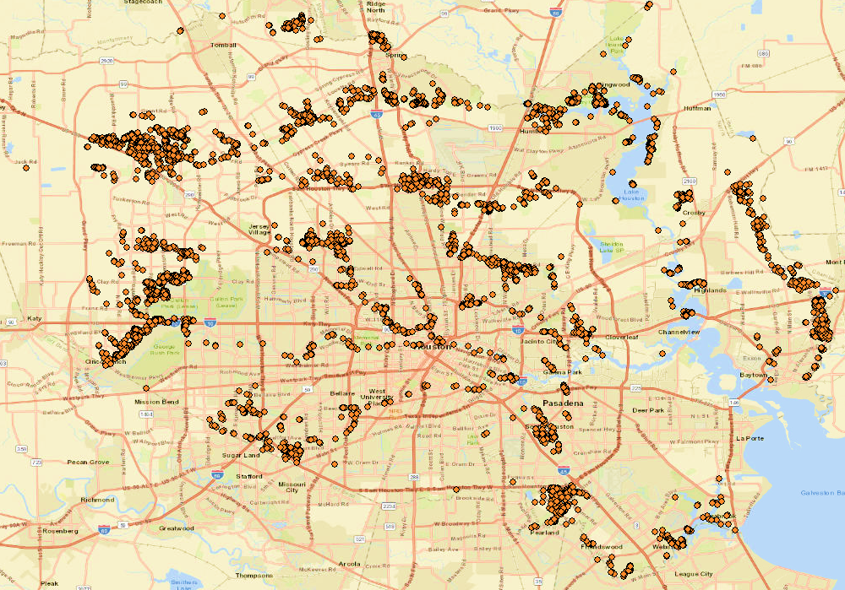
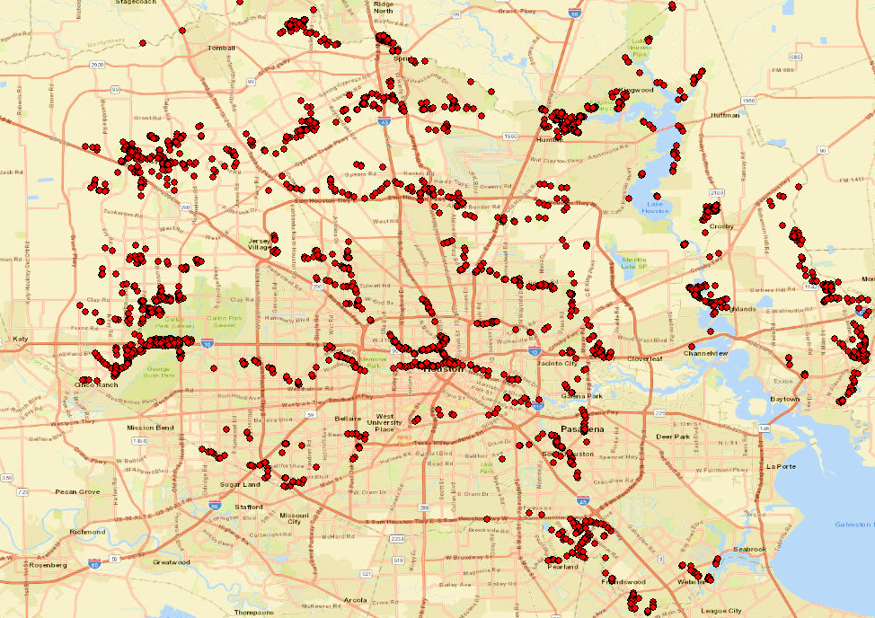
Figure 4a. Affected (5.34E-05 ft – 1.99 ft): 36,922 residential homes
- Source: U.S.
Figure 4b. Minor damages (2 ft – 4.99 ft): 29,796 residential homes
- Source: U.S.
Figure 4c. Major damages (5 ft – 7.99 ft): 19,350 residential homes
- Source: U.S.
Figure 4d. Destroyed (8 ft – 37.07 ft): 13,936 residential homes
- Source: U.S.

Slide 13
References
1)U.S. Department of Commerce, N.W.S., National Oceanic and Atmospheric Administration, Weather Forecast Office Corpus Christi, TX. Major Hurricane Harvey – August 25-29, 2017. Available from: http://www.weather.gov/crp/hurricane_harvey.
2) United States Census Bureau, U.S.D.O.C. 2017 Hurricane Harvey. Available from: http://www.census.gov/topics/preparedness/events/hurricanes/harvey.html.
3) CDC. Social Vulnerability Index 2014; https://svi.cdc.gov/Documents/Data/2014_SVI_Data/SVI2014Documentation.pdf

Slide 14
Questions?
Thank you for listening!

